Slide 1
TSS 2.1
I can identify common computer threats (e.g. viruses, phishing, suspicious email, social engineering, spoofing, identity theft, and spamming)

Slide 2
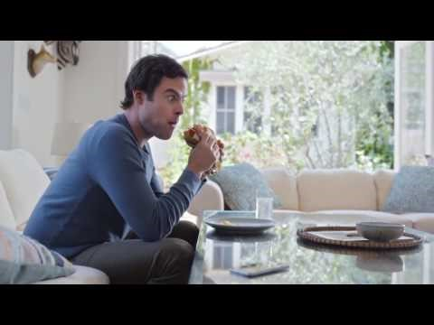

Slide 3
Social engineering
the use of deception to manipulate individuals into divulging confidential or personal information that may be used for fraudulent purposes.
"people with an online account should watch for phishing attacks and other forms of social engineering"

Slide 4
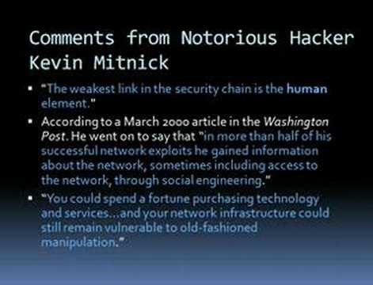

Slide 5

Don’t click!
Being directed to hostile websites and encouraged to download certain “helpful” software are just variations on how the social engineers attempt to bypass any electronic controls which is why you should not click on unexpected and or unknown email attachments. Clicking on them is an important example of poor security practice and bad decision-making.

Slide 6
How to Recognize and Avoid Phishing Scams From the federal trade commision
https://www.consumer.ftc.gov/articles/how-recognize-and-avoid-phishing-scams#recognize

Slide 7
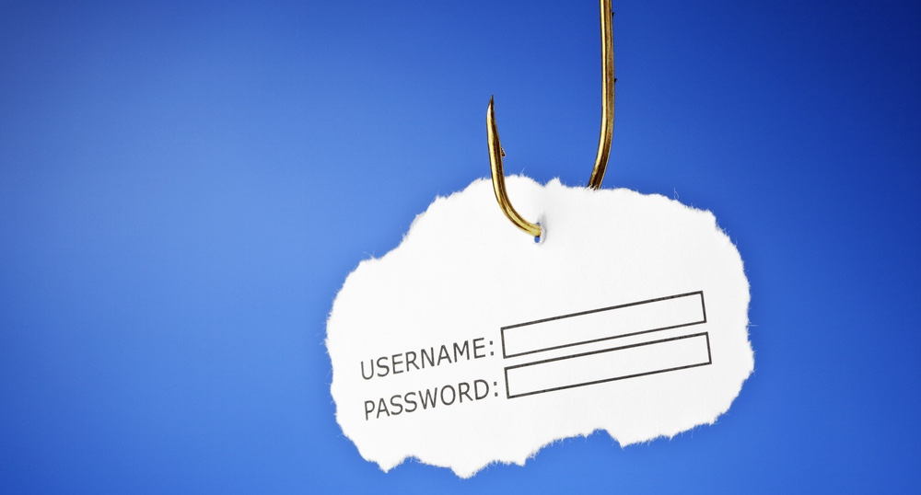
phishing
In addition to widespread phishing, the human firewall knows about two more specific kinds:
Whale phishing attacks target high profile individuals within organizations
Spear phishing attacks target specific organizations and all of the people who are within it.
https://www.opendns.com/phishing-quiz/

Slide 8
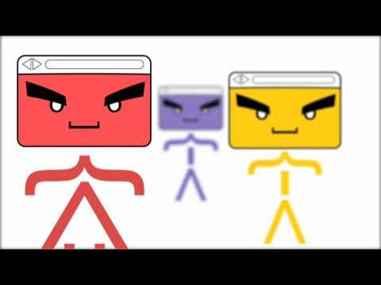

Slide 9
SPAMMING
Spam can be defined as irrelevant or unsolicited messages sent over the Internet. These are usually sent to a large number of users for a variety of use cases such as advertising, phishing, spreading malware, etc.
In the past, spam used to favor email as it was the primary communication tool. Email addresses were relatively easy to harvest via chat rooms, websites, customer lists and that impact a user’s address book. Eventually, email filters became more sophisticated, and more effectively decreased spam from clogging the inbox.
Since then, spammers have moved onto a new target: social applications.
Source: https://thenextweb.com/future-of-communications/2015/04/06/5-types-of-social-spam-and-how-to-prevent-them/

Slide 10
Identity Theft
Identity (ID) theft happens when someone steals your personal information to commit fraud.
The identity thief may use your information to fraudulently apply for credit, file taxes, or get medical services. These acts can damage your credit status, and cost you time and money to restore your good name.
Source: https://www.usa.gov/identity-theft

Slide 11
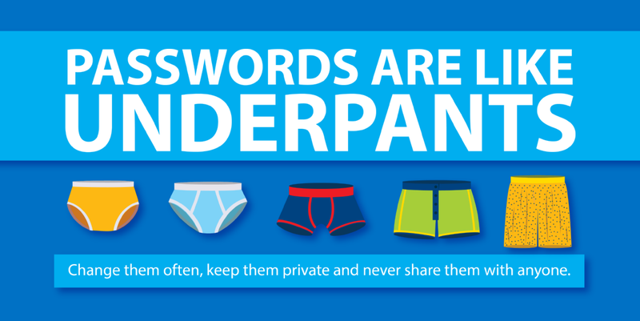
passwords
Employ passwords that are hard to guess and easy to remember.

Slide 12
TSS 2.1
I can identify common computer threats (e.g. viruses, phishing, suspicious email, social engineering, spoofing, identity theft, and spamming)

